Slide 1
Biometric Signature Authentication with Low-Cost Embedded Stylus
Divas Subedi¹, Digesh Chitrakar¹, Isabella Yung¹, Yicheng Zhu¹,
Yun-Hsuan Su², Kevin Huang¹
¹Trinity College, Department of Engineering, 300 Summit St, Hartford, CT 06106 ²Mount Holyoke College, Department of Computer Science, 50 College St, South Hadley, MA 01075

Slide 2
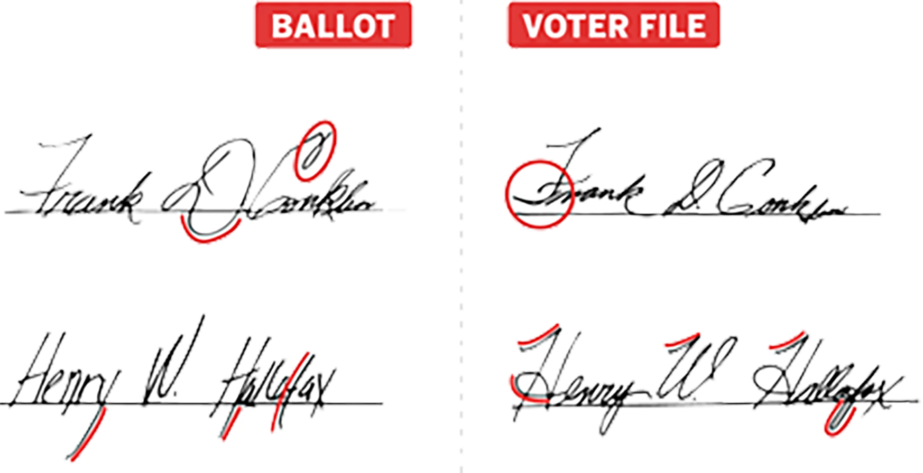
MOTIVATION
Current authentication methods
Passwords, MFA
Signatures have been used as form of authentication
Used in ballots, checks, legally binding papers
Current signature verification methods are not reliable
Extremely manual and expensive undertaking
Observed utility of their expertise over novices are not entirely confirmed
Handwriting and signatures is unique to each individual person
Non-invasive, user-friendly and can be readily integrated into current system
Notes:
Digital Age,→ privacy imp
Go to password | can be forgotten, stolen or cracked
Have MFA but inconvenient
Industry move toward Biometric | finger print/face scanner
Yet another Biometric can be Signature
<Slide>

Slide 3
RESEARCH GOALS
Design and develop a low-cost pen that authenticates users via signature
Propose a novel approach to use signature as biometric authentication
Observe how the signature was written rather than just the outcome
This iteration of the device is based on inertial measurements collected by two accelerometers
Extract features based on collected data
Train a model using the features that can authenticate a signature
Notes:
<Slide>

Slide 4
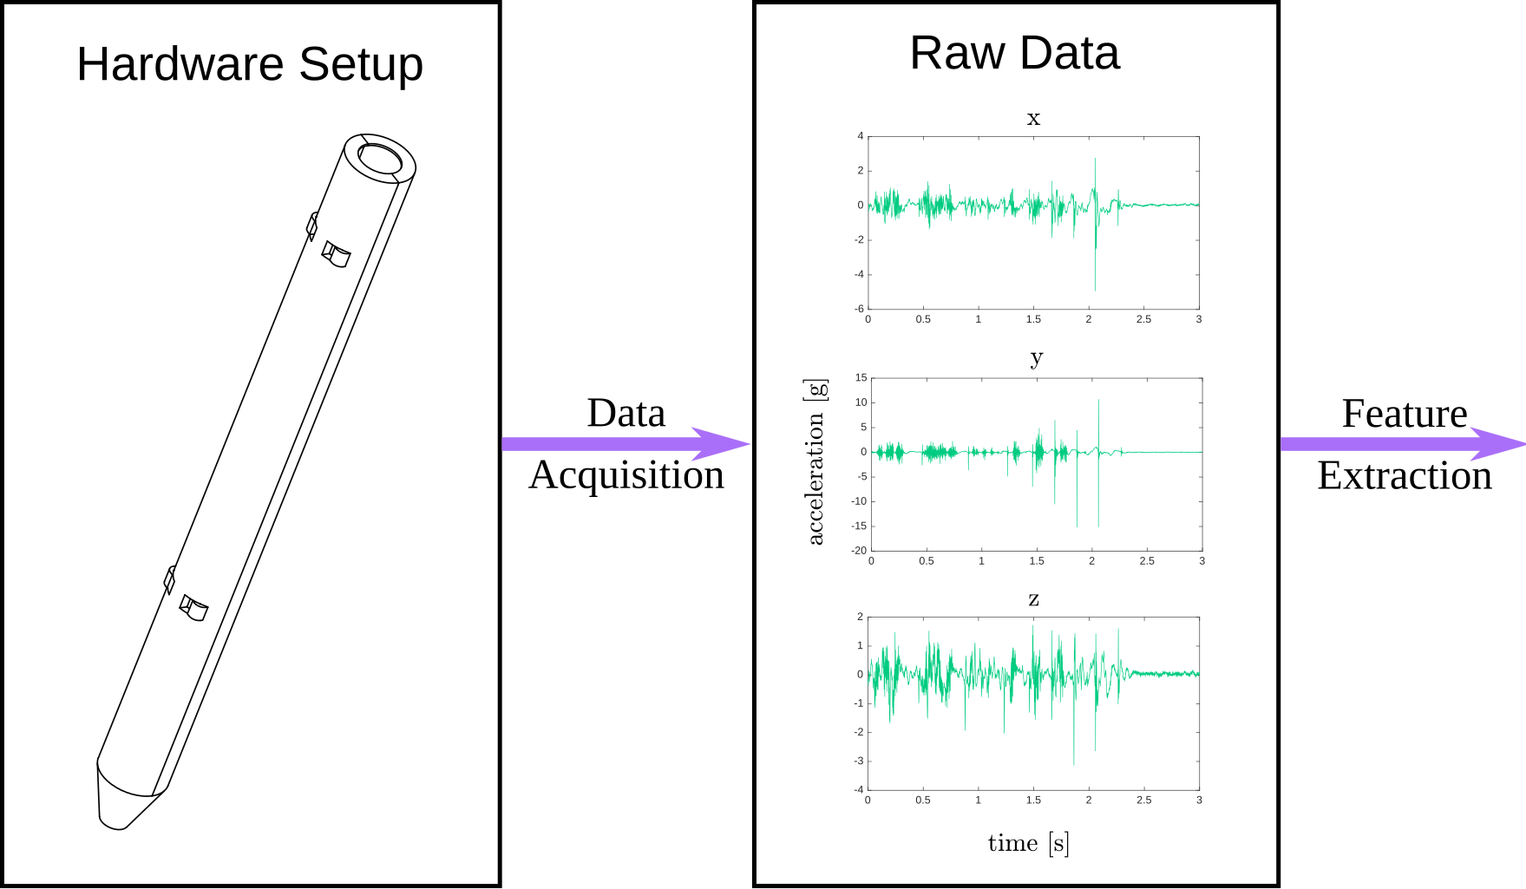
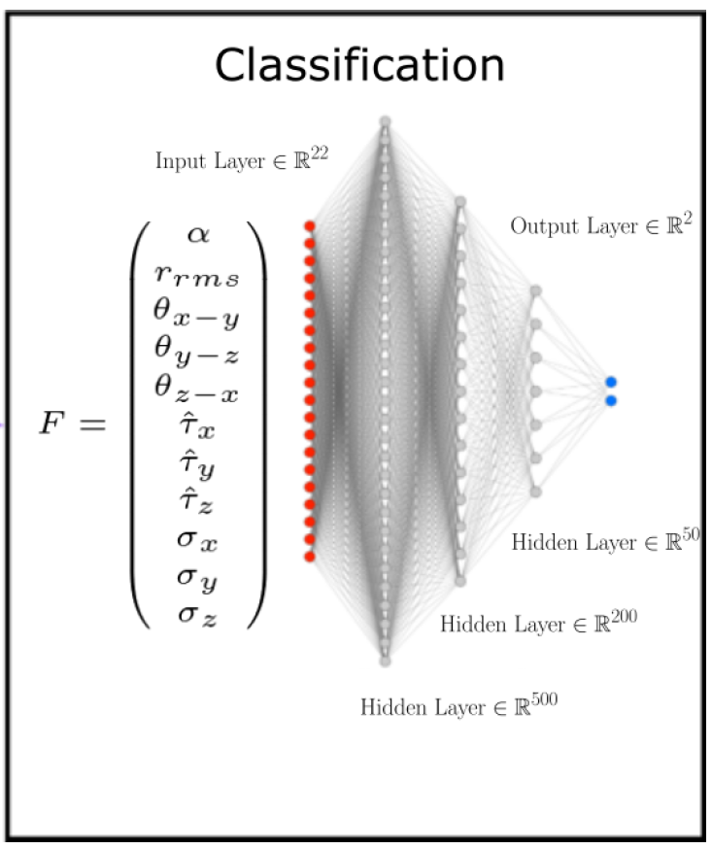
Workflow
Notes:
3D model of stylus that has embedded sensors
Acquire data
Extract Features and Classification

Slide 5
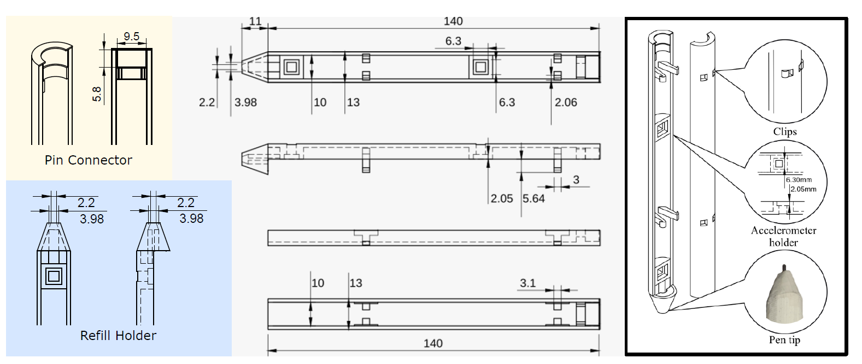
STYLUS Design
Notes:
Schematic of the stylus.
2 notches XLR
One was places right where most people would grip the pen. ➔ data of hand motion.
Other was placed on the further end → data on how the pen moved.
There is also a cavity to hold refills that can hold a regular pen cartridge.
Pin Connector
PVA and ABS for the 3D printed → smooth
~ the size of signature pen

Slide 6
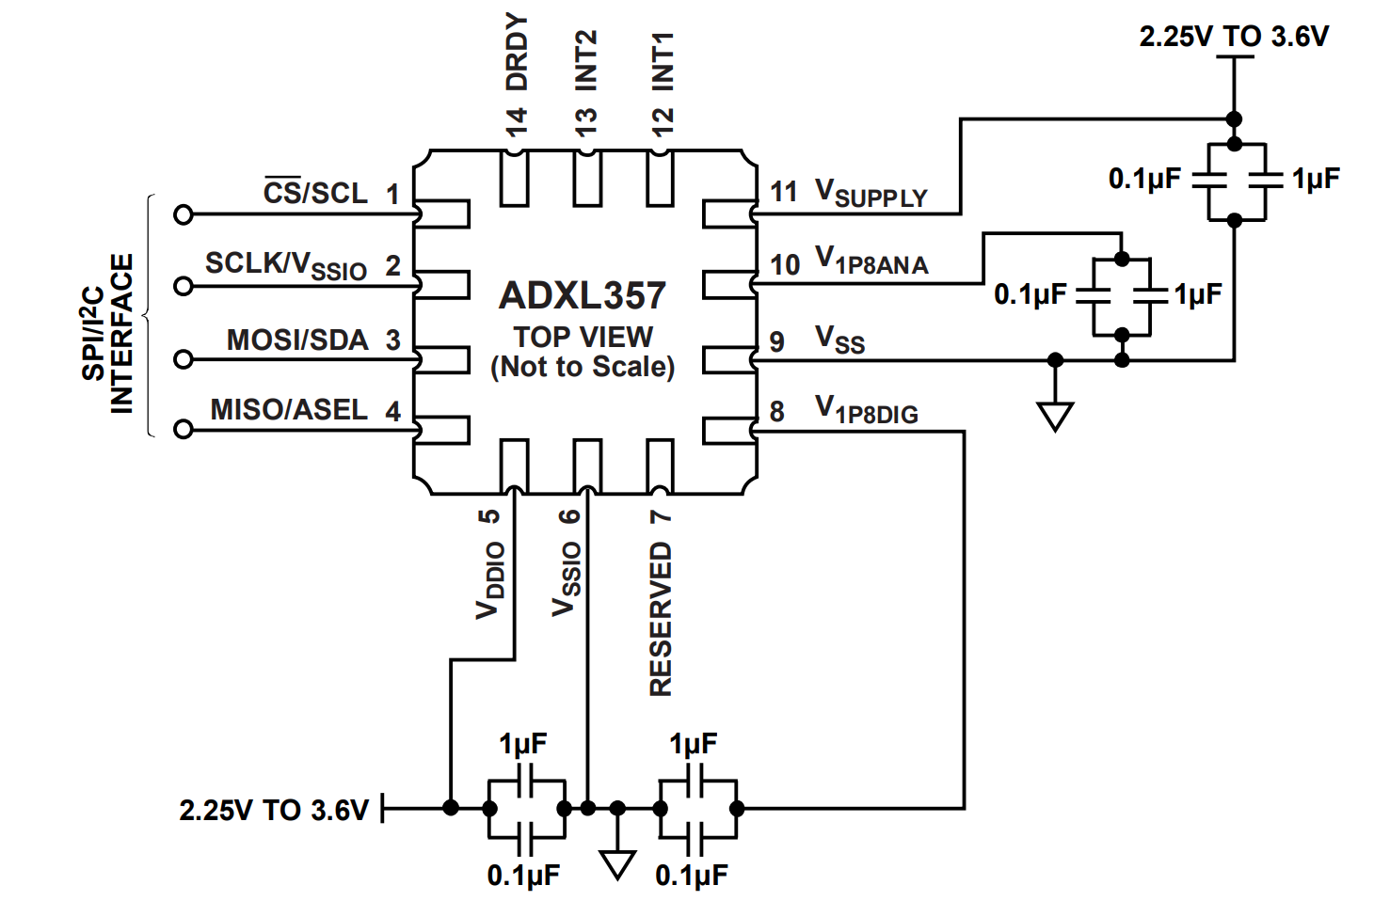
Accelerometer
ADXL357
3 Axes measurement
Bandwidth: 2 kHz
Range: 20g
Sensitivity: 7.23 * 10⁻⁴ g
Serial Peripheral Interface (3.4 MHz)
Circuit layout for one ADXL357
Notes:
Had desired bandwidth, range and sensitivity.
Small size

Slide 7
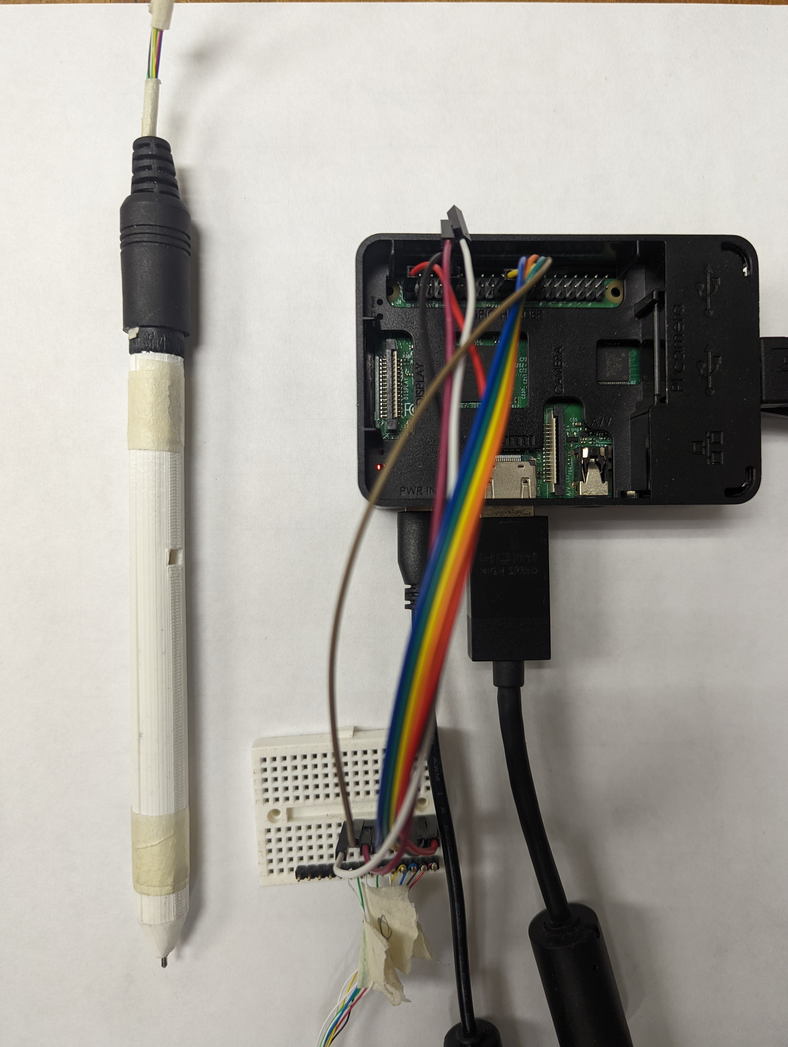
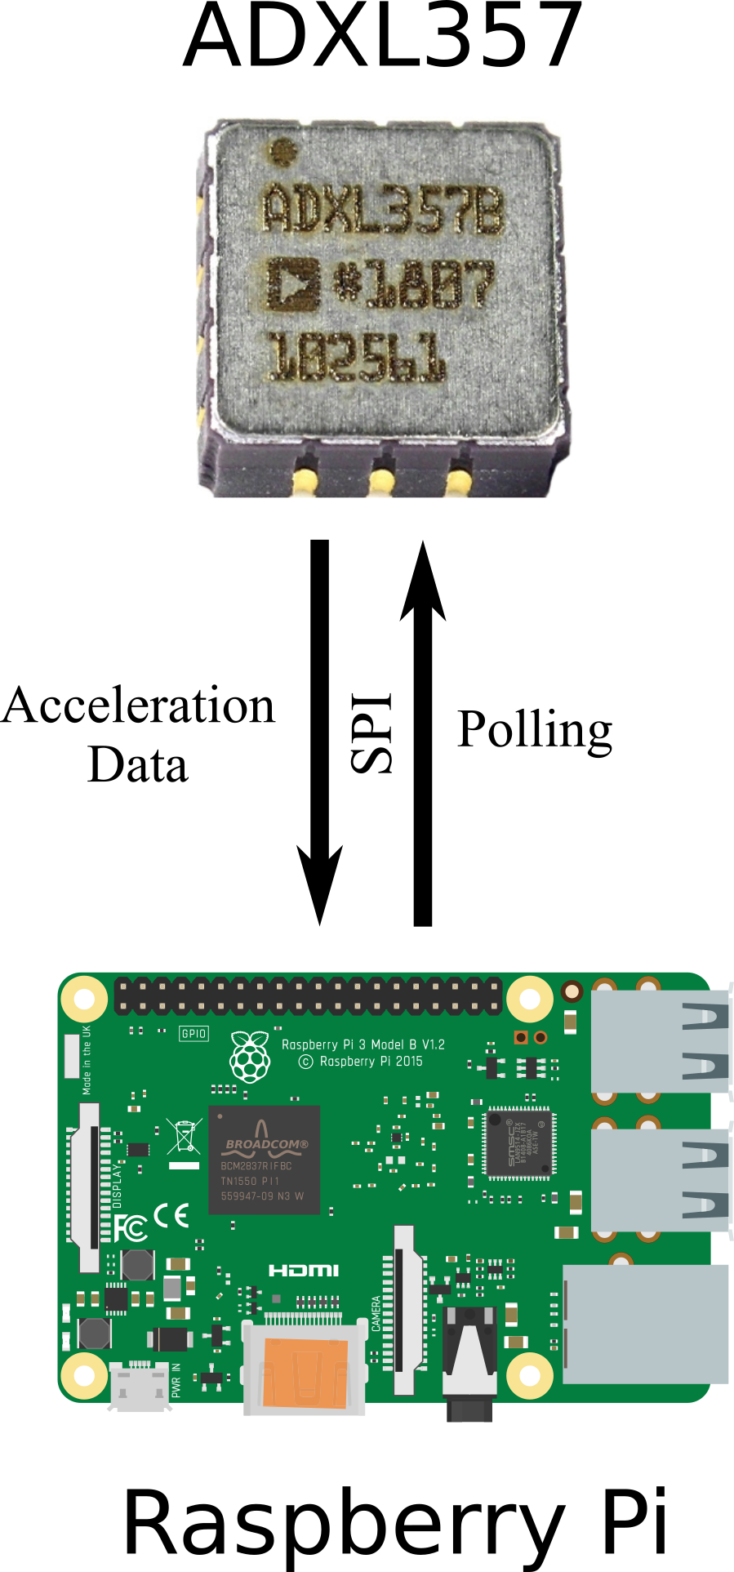
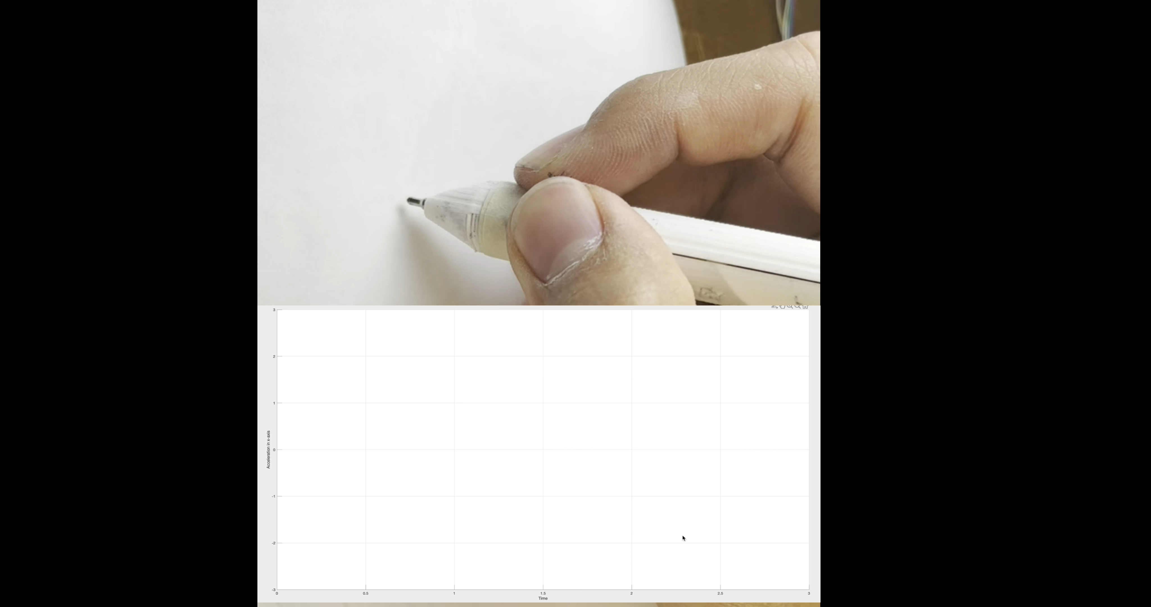
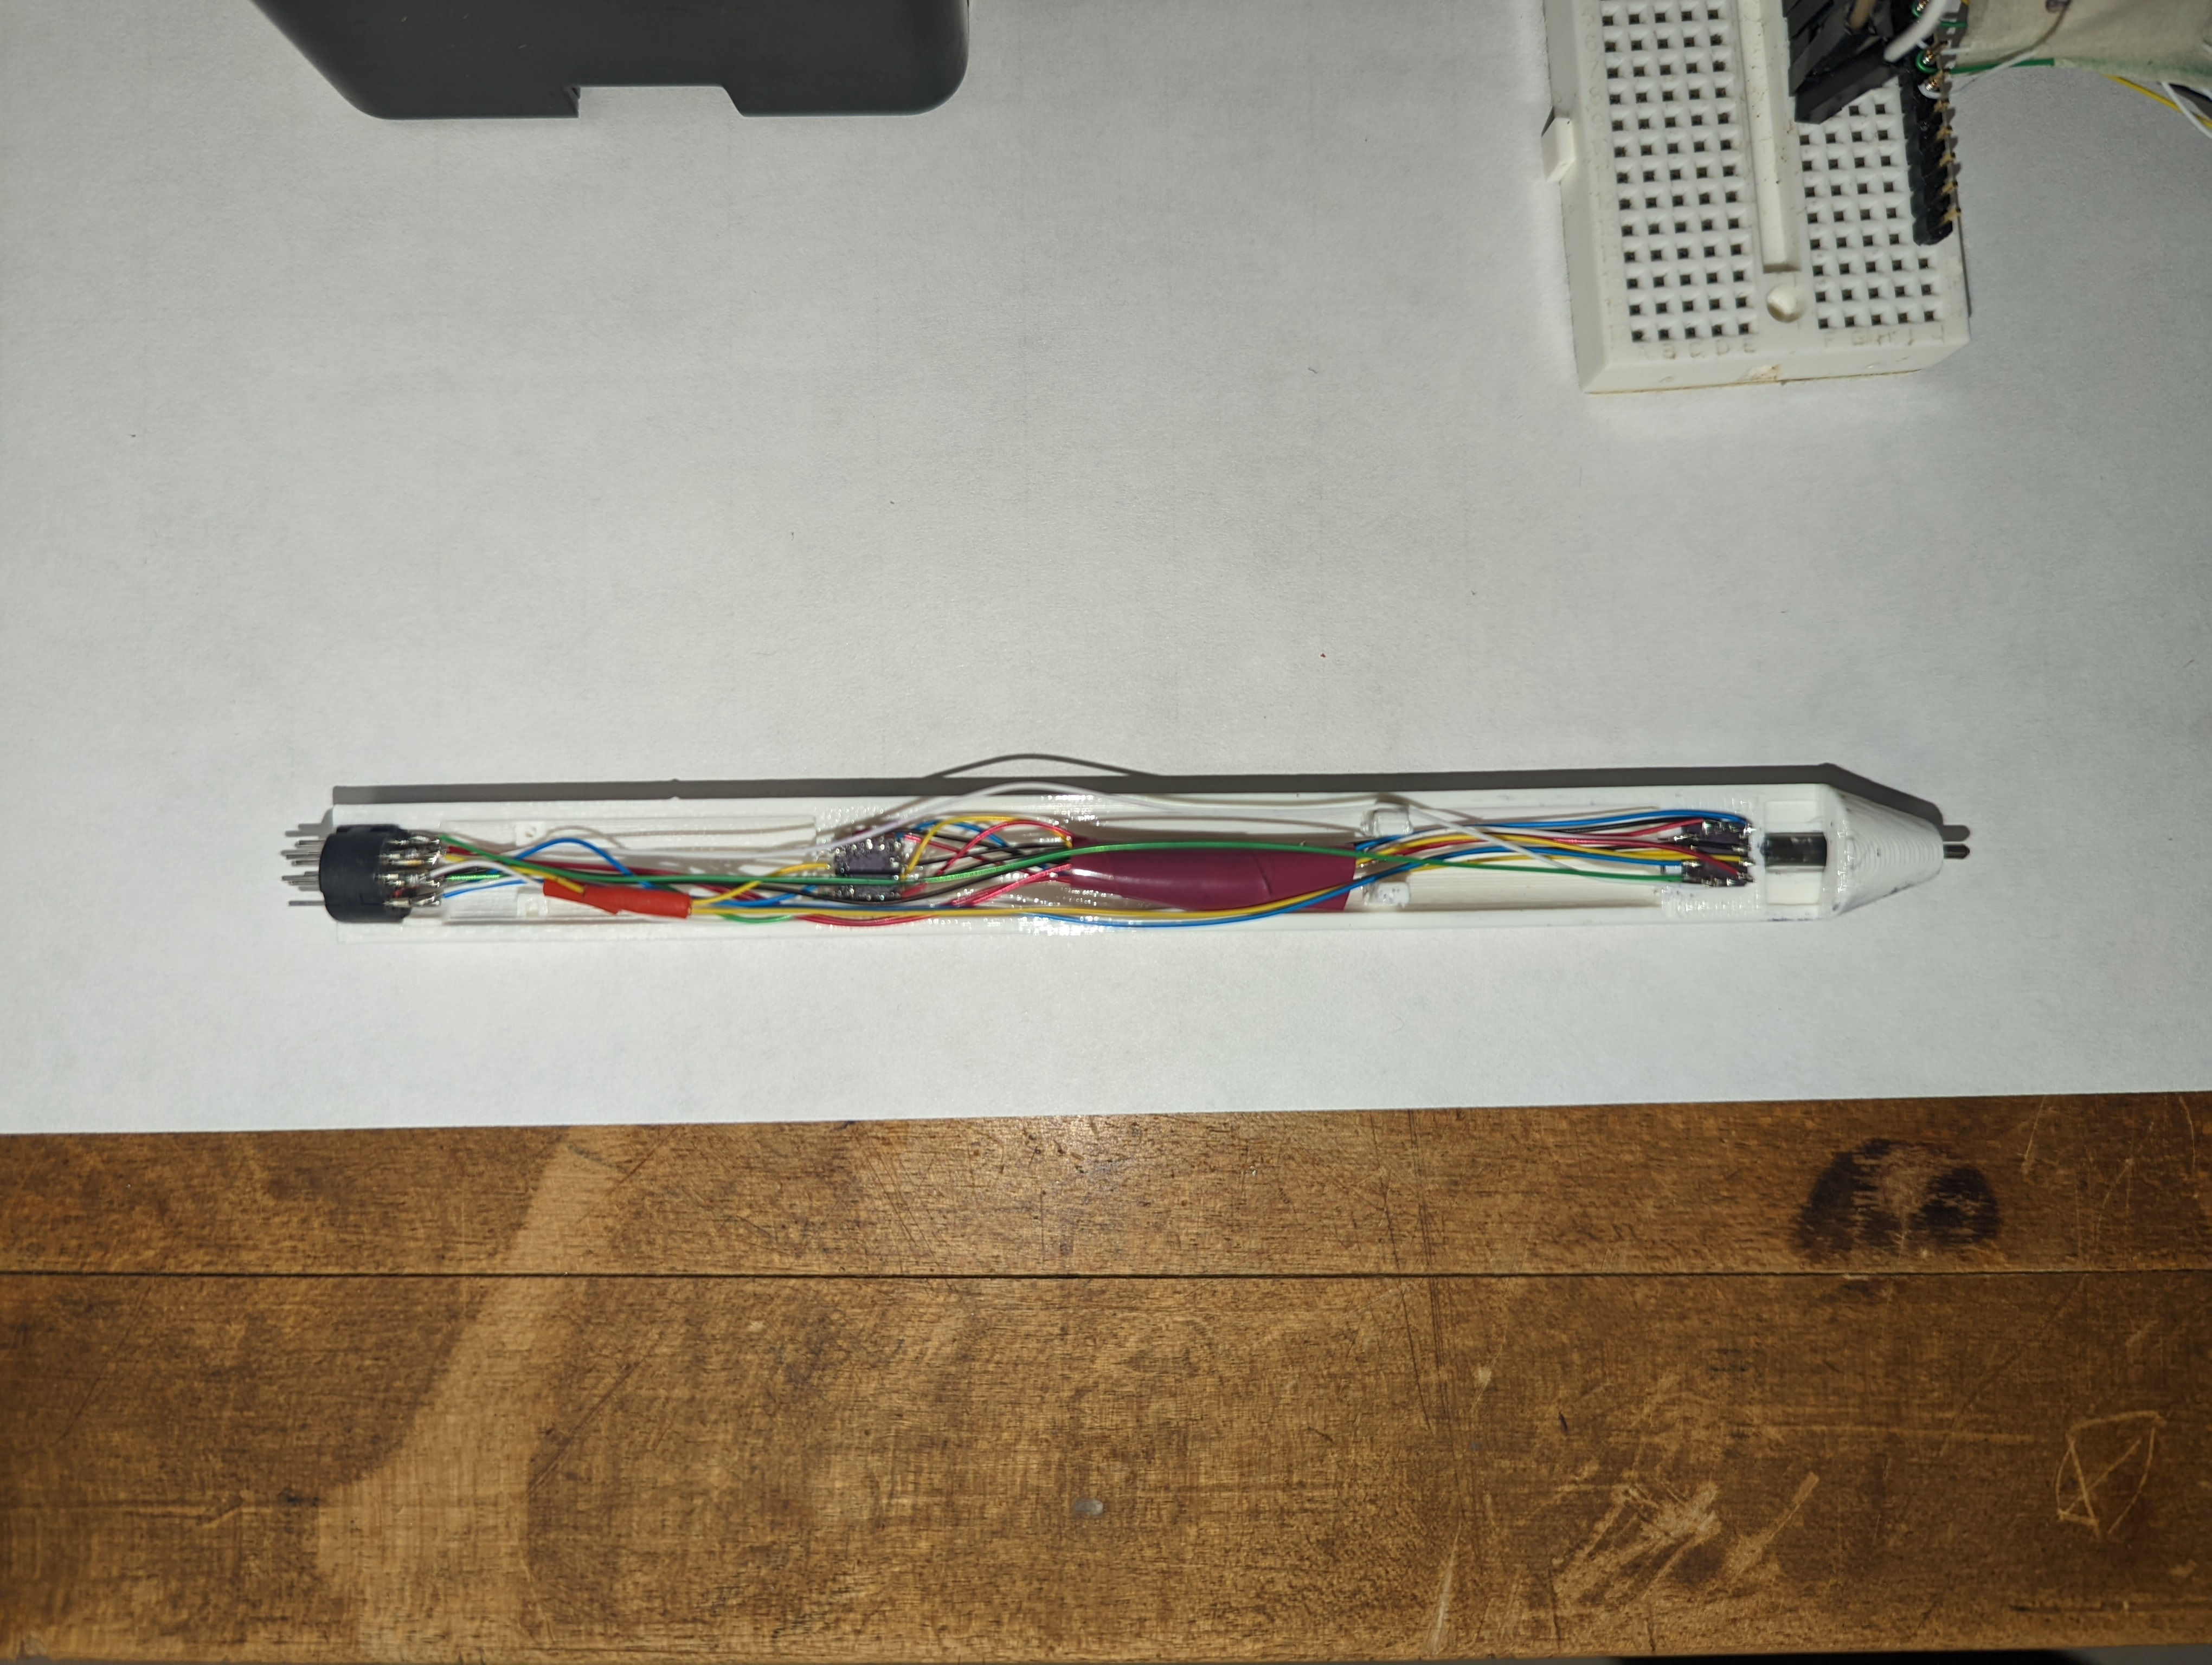
Physical realization of the pen
Data Acquisition
Process
Collection of acceleration data from signature
Notes:
ADXL snug
Pin Connector →SPI → Rpi → SD Card
Pen Cartridge
Signature Process

Slide 8
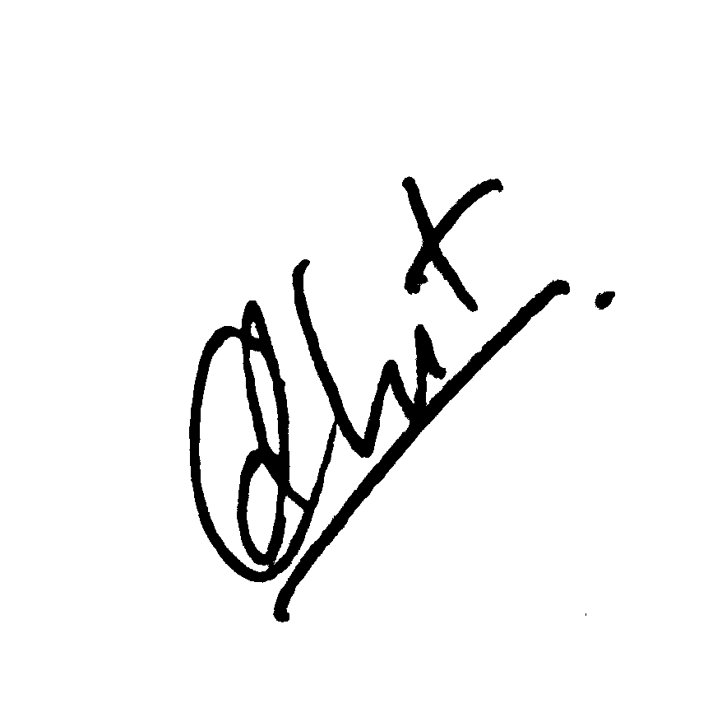
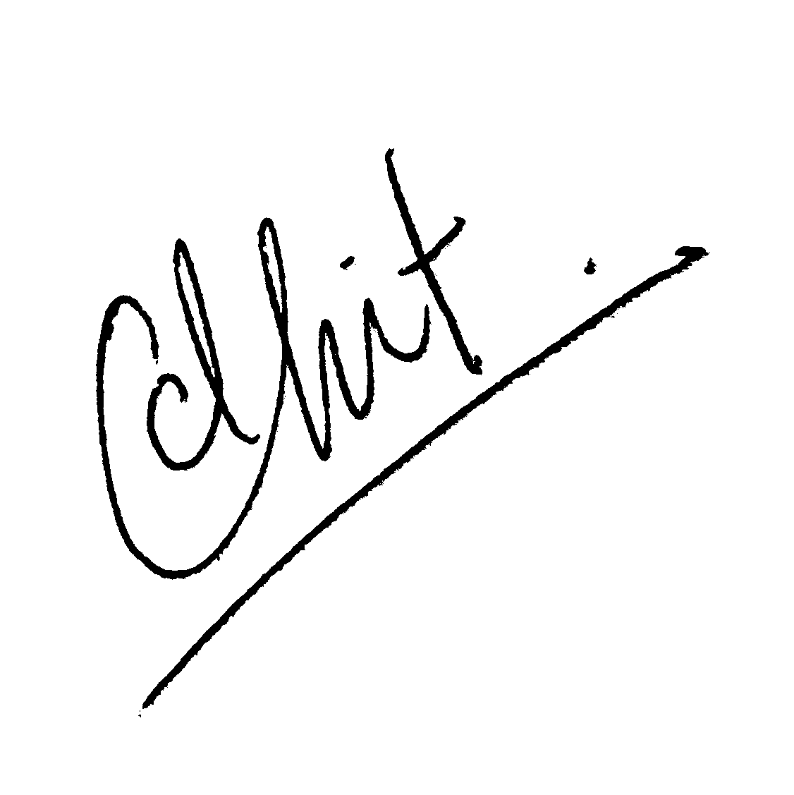
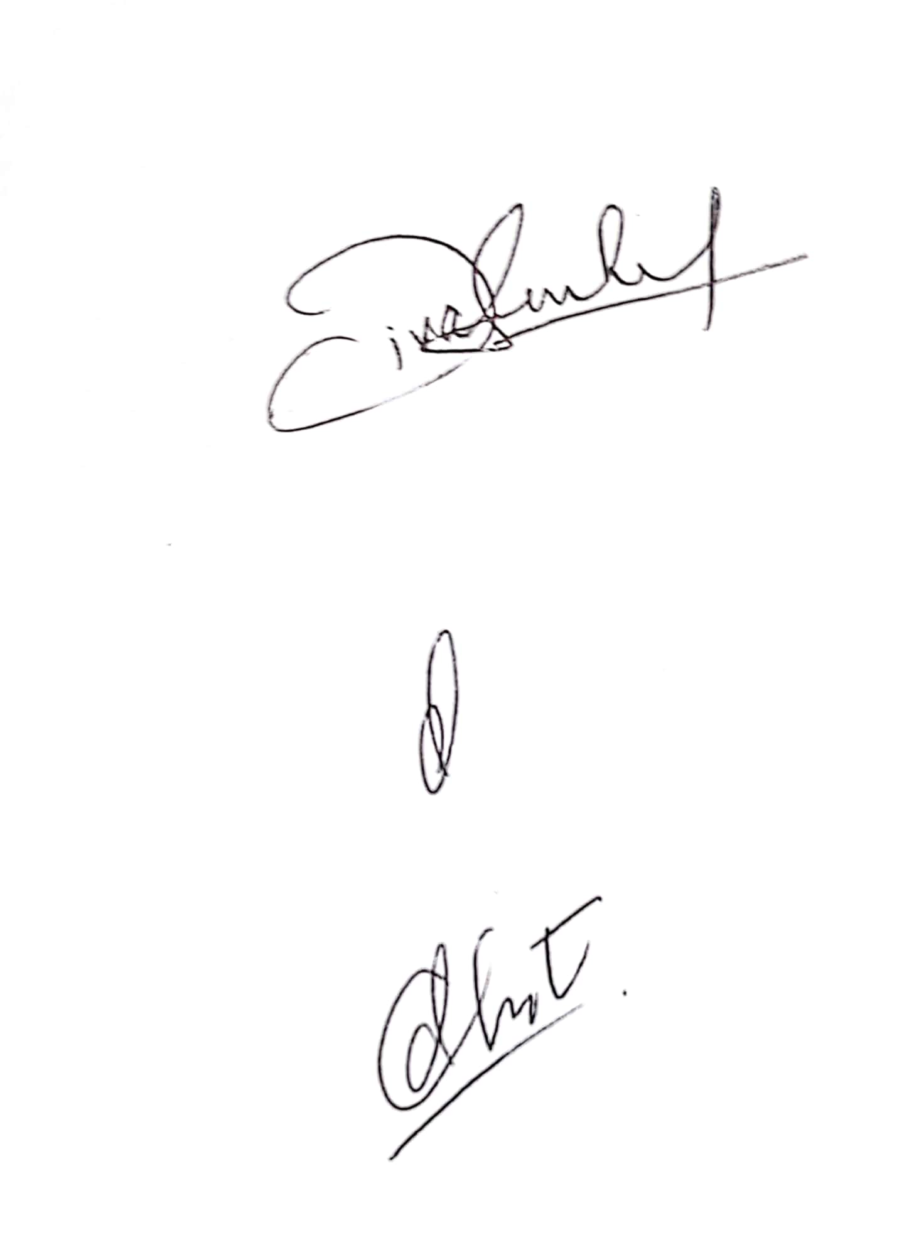
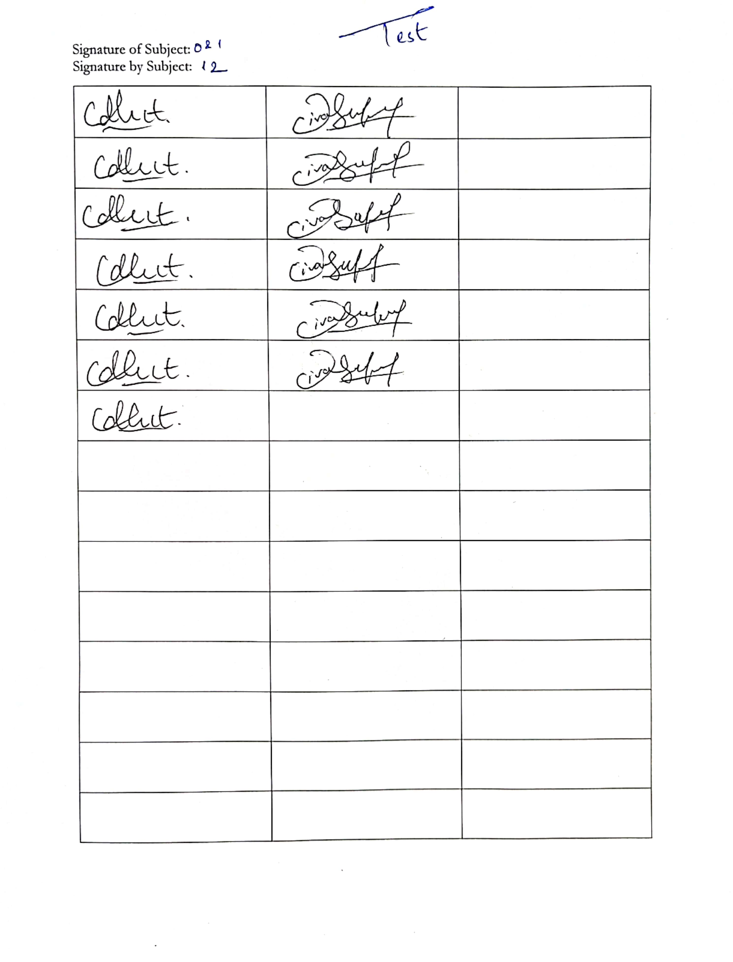
Data Collection
Two separate users’ signatures served as authentication targets: Subject 0 and Subject 1
Two signature labels were collected: Authentic and Forged
Authentic Signature [2 Subjects]
212 signatures
Forged Signature [8 Subjects]:
30 forged signatures
15 random words/scribbles
Subject 0
Subject 1
Authentic
Forged
Notes:
Two different model: two users’ signature
<Slide>
Sub 0 → 3 seconds
Sub 1 → 5 seconds
Ofc, ideally we would want to have no caps
<Slide>

Slide 9
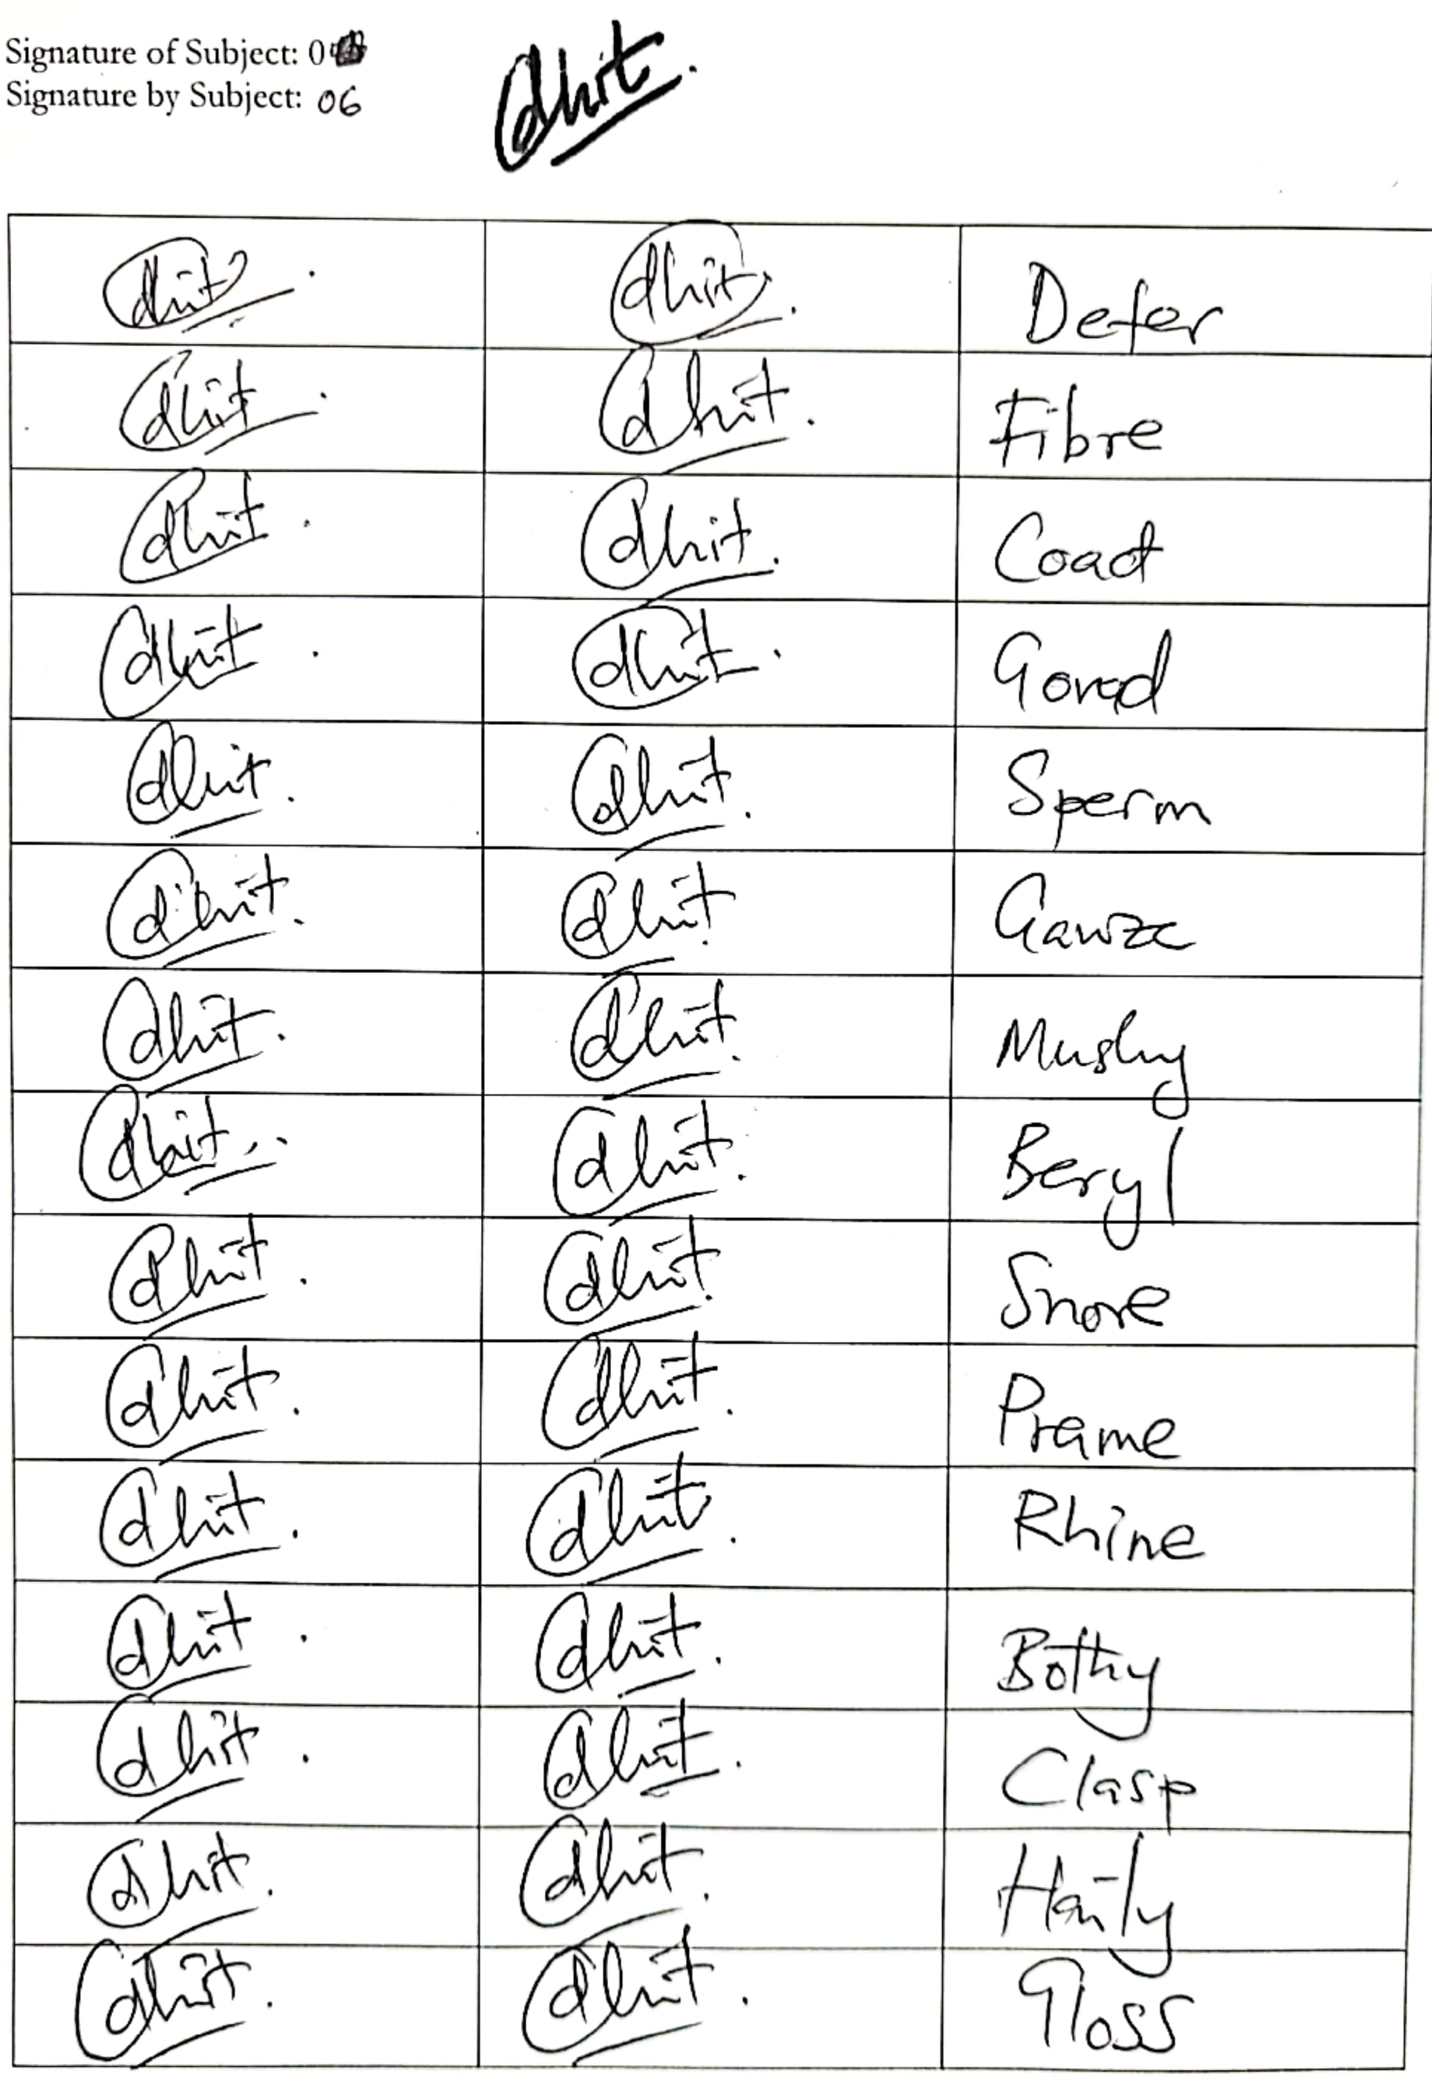
Data Collection
The subjects were all right-handed and between the ages of 18 and 23 years old
A brief introduction to the forgery task included:
an introduction to the embedded device
a description of the time duration:
under 3 seconds for Subject 0
under 5 seconds for Subject 1
for each signature class, a copy (to scale) of the authentic signature graphical output
time for the forger to practice with the pen to forge the target signature (20 minutes or whenever satisfied)
Notes:
On right, we have the forger’s sheet: graphical output of authentic signature
30 forged signature, 15 scribbles/random word
<Slide>
Training/Data collection could end whenever they wanted

Slide 10
Data Collection
For both Subject 0 and Subject 1 signatures, a database is collected that includes acceleration time series for:
212 handwritten positive (authentic) signatures;
343 handwritten negative (forged) signatures, consisting of:
- 238 forged replicas of authentic signature;
- 105 random words/scribbles.
Each type of signature thus includes a total of 555 collected samples as a dataset
Notes:
<Slide>

Slide 11
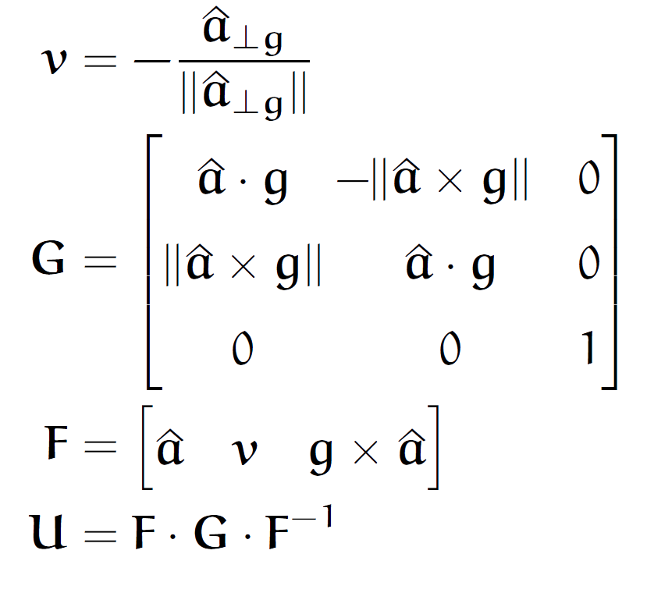
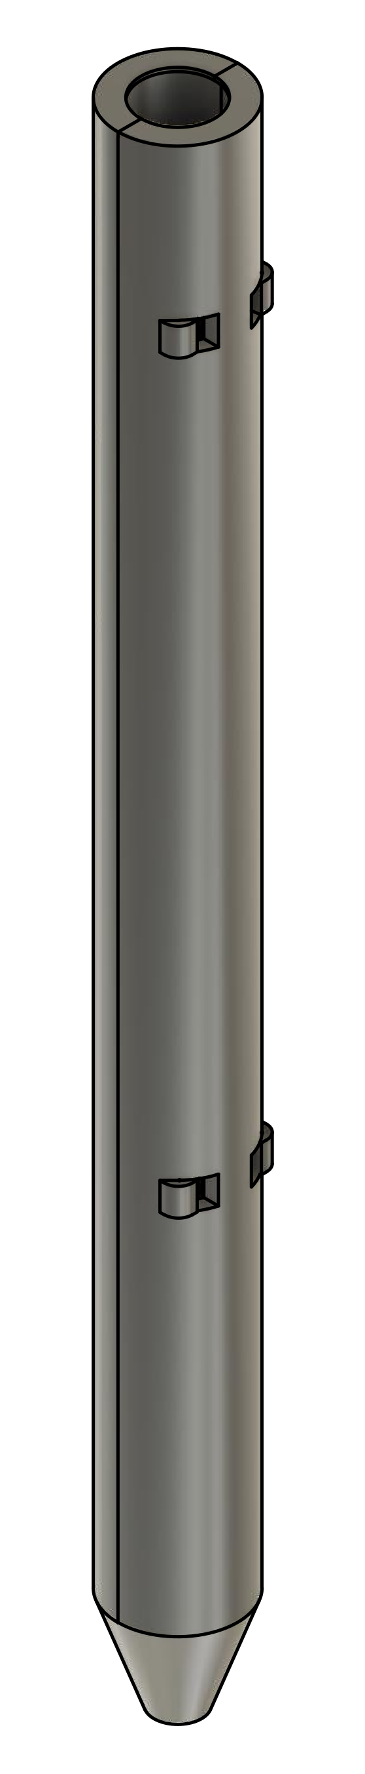
Orientation Normalization
Notes:
Pen symmetric about long axis → pose problem to data collection and feature extraction
Orientation could vary between the signature and between the user shifting the data between the axes.
Counteracted → normalizing the orientation.
Gravity as the reference vector and rotate all the data such that the pen orientation would align to the reference vector.
That way all the data collected was orientation normalized.

Slide 12
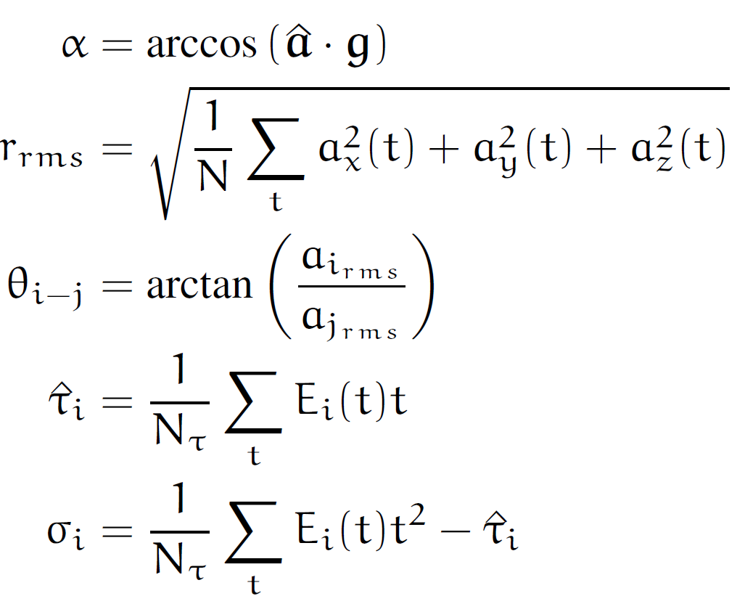
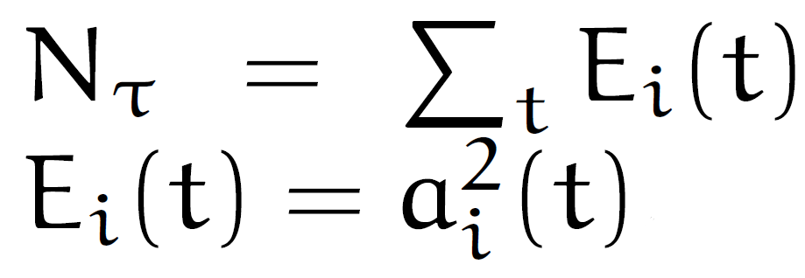
Features
Notes:
To create manual feature, we used common ways that signature or hand motion would vary.
Here we have the orientation of the pen (angle between tilt and gravity)
R_rms: This is measure of the total energy that was put into the signature. Some people sign with vigorous hand movements while some do it gently.
Rest is measure of distribution of energy in the signature. Theta here measures the ratio of energy put between the axes.
Tau and Sigma measures the temporal distribution of energy. Tau measures mean while sigma is the standard deviation

Slide 13
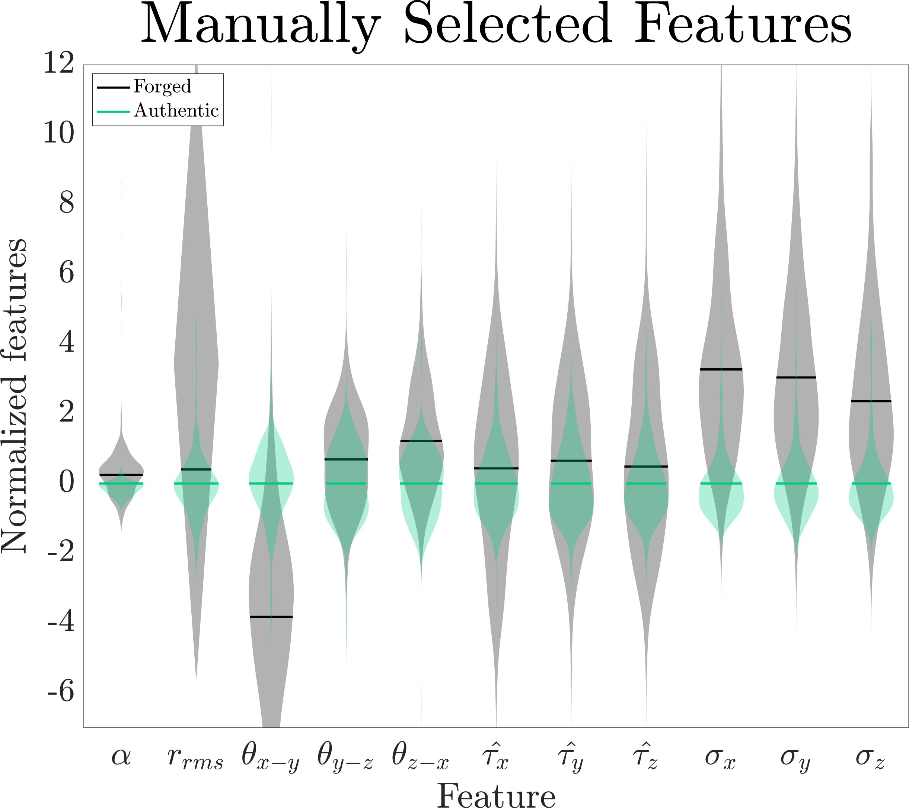
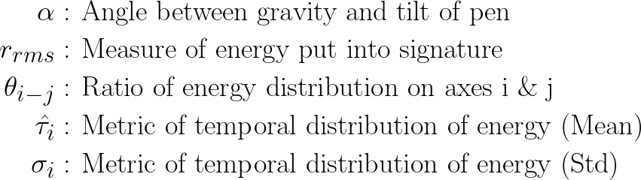
Notes:
Here is a bean plot of the distribution of feature across the databases stratified to authentic and forged data. Here the features are normalized against the mean and std of authentic data
We had 11 features from 1 accelerometer. 22 from 2

Slide 14
Classification
A Multilayer Perceptron Neural Network was trained with manually selected features
Input: 22 manually crafted features in F
Structure: Three hidden layer with 500, 200, and 50 perceptrons in each layer respectively
Optimization: This model optimized the log-loss function using Limited-memory Broyden– Fletcher–Goldfarb–Shanno (LBFGS)
Training: An 80-20 split was heuristically determined
Each dataset was split into 5 distinct folds with uniform distribution of authentic and forged signatures
Notes:
Now that we’ve extracted the feature, we use a MLP neural network to train with the feature. It has input sized of 22 and output of 2. (authentic or not)
The neural network had three hidden layers: with 500, 200 and 40 perceptrons
The model used LBFGS to optimize the log-loss function
While training we split the data 80-20 that was determined heuristically
We used k-fold cross validation with 5 distinct folds with more or less uniform distribution of authentic and forged signatures

Slide 15

Results

Slide 16
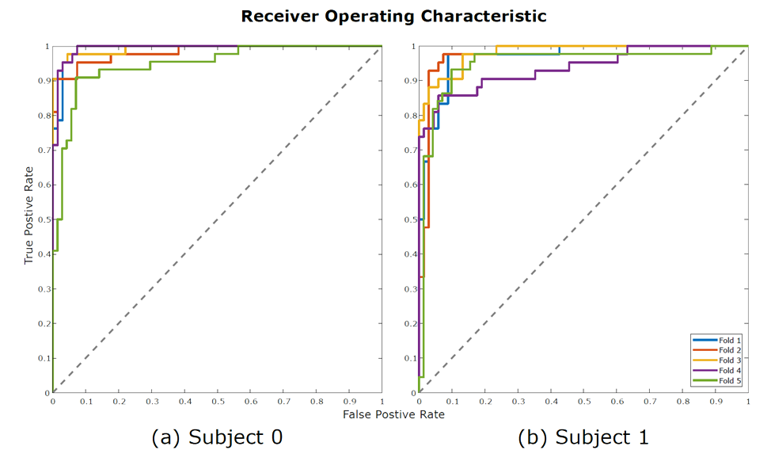
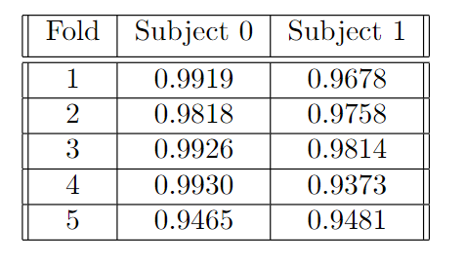
Receiver Operating Characteristic
AUC
Subject 0
Subject 1
Notes:
For all folds

Slide 17
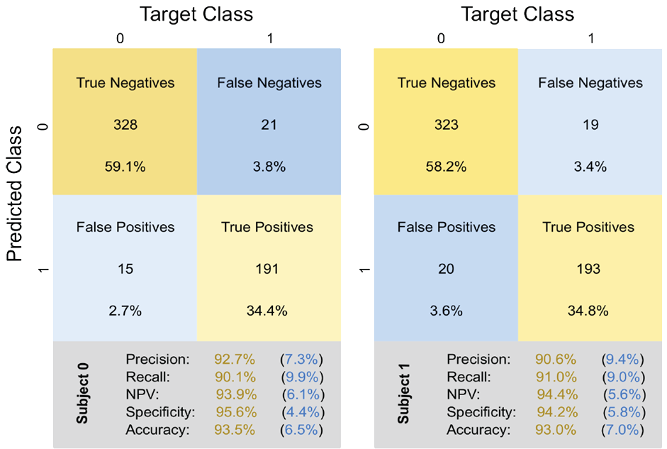
Notes:
This shows the confusion matrix for two signature types. We have high specificity of above 94% and accuracy above 93%. which is pretty robust for a low-cost device and has shows great promises for future work.

Slide 18
Future Works
Addition of more sensors like pressure sensor and gyrometer
Exploration of other feature extraction and training techniques
Explore on possibility of text transcription with this device
Expanding the study to have more signature as authentication target
Notes:
Here are some plans / direction for future works. We are planning to add more sensor such as pressure sensor/gyrometer through we would be able to get more features
We plan to explore other feature extraction and training techniques
We would also like to explore on the possibility of text transcription with this device.

Slide 19

Thank YOU
Thank you for your attention. The authors would like to thank the AIM 2023 organizing committee and welcome all questions via email at kevin.huang@trincoll.edu
This work was done as an extension to the Senior Engineering Capstone Project 2022. We would like to acknowledge Trinity College and Travelers Insurance for funding the project and making this research possible. We would also like to thank Dr Clayton Buyers for his support.

Slide 20

Questions

Slide 22
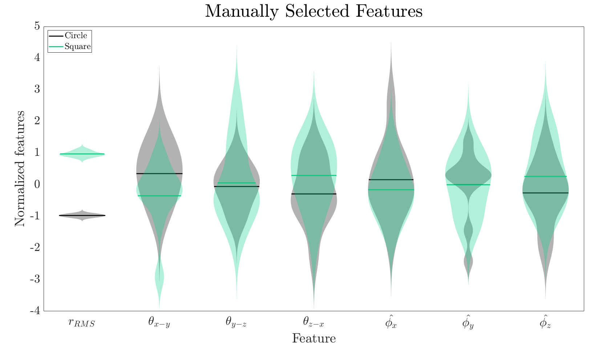
Feature Difference Between
Squares and Circles

